Slide 1
Comparison of CutShort: A Hybrid Sorting Technique using MPI and CUDA
Harshit Yadav, Shraddha Naik, Ashwath Rao B, Shwetha Rai and Gopalakrishna Kini N
Department of Computer Science and Engineering, Manipal Institute of Technology, Manipal Academy of Higher Education, Manipal, Karnataka, India, 576104
Slide 1/27

Slide 2
Introduction
Applications of Sorting are found almost everywhere.
CutShort algorithm which works on the bit count operation.
The word “CutShort” is self-explanatory i.e. cutting an input array into smaller pieces of array.
These sub arrays are then fed to Merge sort or quick sort or Insertion sort algorithm
Slide 2/27

Slide 3
Literature Survey
Various algorithms like Quick sort, Merge Sort , Insertion sort were considered[1]
Cut Short Algorithm[4] + (Quick Sort /Merge Sort/ Insertion Sort)
When this algorithm is used with CutShort Algorithm the time complexity is reduced to n log(dmax) in best case time complexity.
Proposed model which would combine the CutShort Algorithm with Parallel Computing framework which would greatly improve the efficiency and achieve scale up.
​
​
Slide 3/27

Slide 4
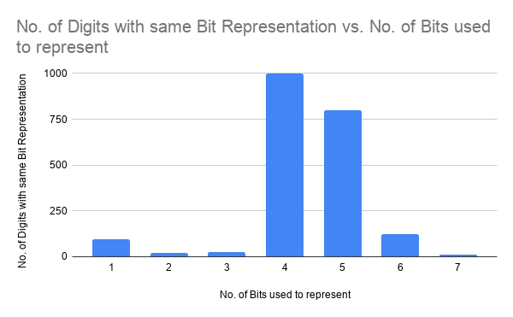
Cutshort Algorithm
Works Best when the Max Number of digits have a the same number of bits used to represent them
​
​
Image :1
Slide 4/27

Slide 5
Cutshort Algorithm
Best Case : T(n) = O( n log (n) – n log (Dmax))
(Dmax) is the maximum number of subarrays obtained from original array.
Average Case : T(n) = O( n log (n) – n log(D) )
Where D is number of resulting sub-array
Worst Case : T(n) = O(n.log n)
In worst case, the time complexity will remain the same O(nlog n)
Slide 5/27

Slide 6
Methodology
CutShort algorithm works on four steps as mentioned below.
1. Initial step
2. Range defining step
3. Rearranging
4. Sub array sorting
Slide 6/27

Slide 7
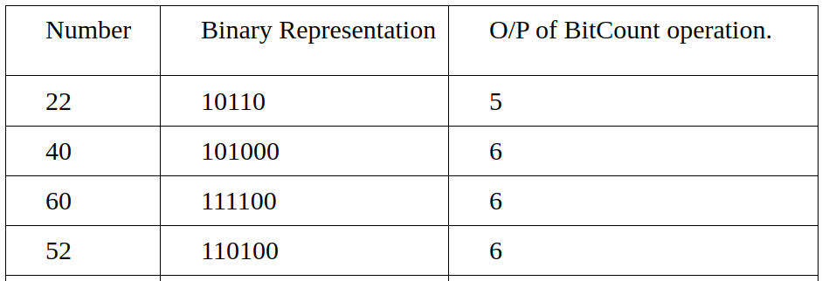
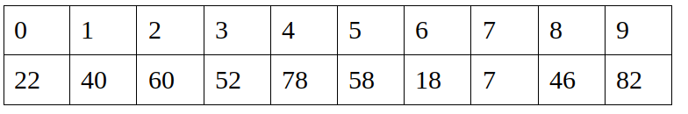
Initial Step
Image : 2
Image : 3
Slide 7/27

Slide 8
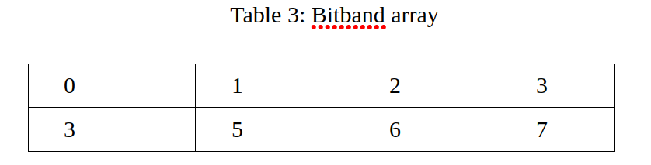
Initial Step
Creating a Bit band array storing the count of number of elements having same digits in bit representation
Image : 4
Slide 8/27

Slide 9
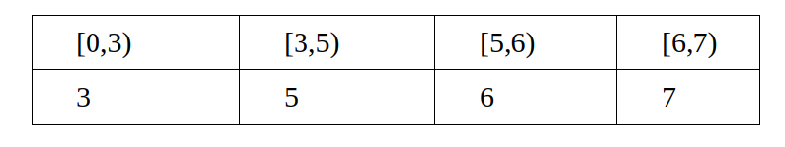
Range defining step
Image : 5
Image : 6
Slide 9/27

Slide 10

Rearranging
In this step, the elements of array are rearranged according to the no of bit count values. Integers with same bit count are placed together one after the other in a sequential manner in an array
Image : 7
Slide 10/27

Slide 11
Sub-Array Sorting
Each of these sub arrays can be sorted using any sorting technique by using the Bitband array to define the different range of bits present in the Input Array. Merge Sort, Quick Sort or Insertion Sort can be used for sorting
Slide 11/27

Slide 12
Proposed Model
CutShort Algorithm with MPI
CutShort Algorithm using CUDA
Slide 12/27

Slide 13
Message Passing Interface (MPI) Architecture
Message Passing Interface is a framework that creates an environment for parallel programming by providing libraries in C/C++ Programming
MPI gives a large set of inter-process communication.
MPI gives a standard interface to the programmers that allow them to write parallel applications that are supported across various platforms
Slide 13/27

Slide 14
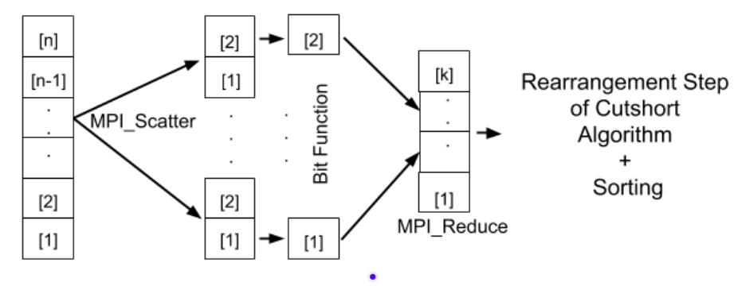
Proposed Parallel execution Model (CutShort Algorithm with MPI)
Image : 8
Slide 14/27
Notes:
In the Proposed execution Model of using the Cut Short Algorithm using the MPI Model we achieve the parallelism by using the MPI framework API MPI_Scatter and MPI_Reduce to achieve parallelism where the the total input data is split into sub arrays of equal size which is computed by each process in parallel allowing to achieve speedup in execution time as compared to its sequential execution .

Slide 15

CUDA (Compute Unified Device Architecture)
CUDA is a parallel computing API Model created by Nvidia
The CUDA platform is designed to work with programming languages such as C, C++ and FORTRAN.
CUDA program consists of 1 or more phases that are executed on either CPU or a device such as GPU
The phases that exhibit little or no parallelism are implemented on host code
The phase that requires rich amount of parallelism is implemented on device code.
Slide 15/27

Slide 16
Proposed Parallel execution Model (CutShort Algorithm with CUDA)
We parallelize the sequential algorithm by sending the input array to the kernel where each thread process the Bitcount function(Initial step of CutShort Algorithm).
Result is stored in separate bitmap array in global memory which is shared among all the kernel
Bitmap array obtained after completion of all threads is processed sequentially in Rearranging step of the CutShort algorithm and its result can be sorted with any sequential or parallel sorting algorithm of choice
Slide 16/27

Slide 17
Experiment
For the tests a sample space of ten thousand elements was taken which was timed by running sequentially
Sample Case was Divided into three Categories :
Worst Case - sample space are in range from 2^{i} to 2^{i+1}
Random Values - all randomly chosen numbers
Best Case - elements can be equally divided into equal bit range buckets
Slide 17/27

Slide 18
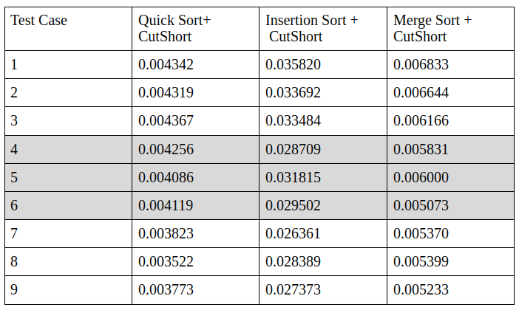
Experiment
Time Taken by Different Serial Algorithms(in sec)
Table :1
Slide 18/27

Slide 19
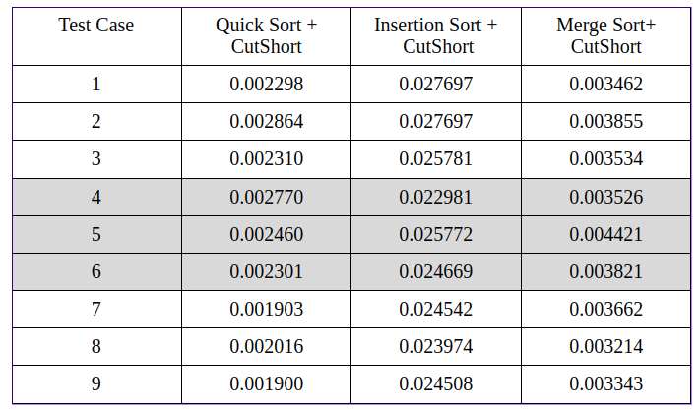
Experiment
Time Taken by Different Parallel Algorithms(in sec) in MPI
Table :2
Slide 19/27

Slide 20
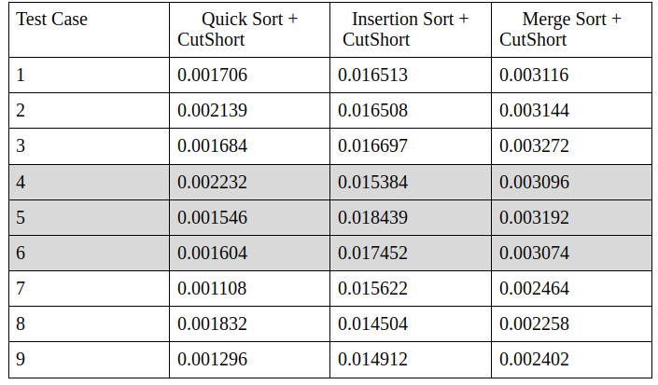
Experiment
Time Taken by Different Parallel Algorithms(in sec) In CUDA
Table :3
Slide 20/27

Slide 21
Experiment
Time Taken by Different Parallel Algorithms(in sec) In CUDA
Table :4
Slide 21/27

Slide 22
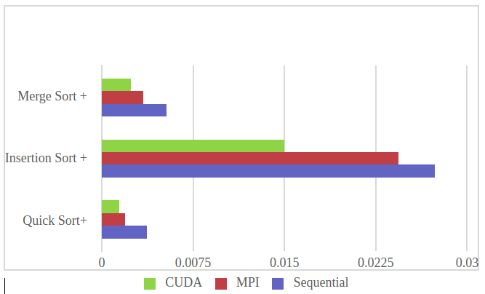
Result and Analysis
We achieved a speedup of greater than 30% as shown in Figure by implementing it parallelly in CUDA or MPI individually as compared to running the algorithm sequentially with the same data set.
Image : 9
Slide 22/27

Slide 23
Conclusion
Speedup achieved is greater in case of CUDA framework due to higher core counts available for parallel processing .
Using the MPI framework which utilizes the CPU cores a minimum of ~30% of speedup is achieved in the best case scenario .
The Proposed models provide a significant performance gain over the existing sequential Cutshort algorithms especially in the use case where the data satisfy the cut short algorithm use case criteria
Even higher speedup can be achieved if the sorting algorithm used is also implemented in parallel
Slide 23/27

Slide 24
References
Thomas H. Coreman, Charles E. Leiserson and Ronald L. Rivest, Introduction to Algorithms, MIT Press, Third edition, 2009.
Traditional insertion algorithm – en.wikipedia/wiki/Insertion_sort, three lines implementation and five-lines optimized version by Jon Bentley (1999), Programming Pearls. Addison-Wesley Professional.
Bender, Michael A; Farach-Colton, Martín; Mosteiro, Miguel (2006), Insertion Sort is O(n log n) SUNYSB; http://citeseerx.ist.psu.edu/viewdoc/summary?doi=10.1.1.60.3758
A. Garg, S. Goswami and V. Garg, "CutShort: A hybrid sorting technique", 2016 International Conference on Computing, Communication and Automation (ICCCA), 2016. Available: 10.1109/ccaa.2016.7813705 .
Link: en.wikipedia.org/wiki/Sorting_algorihm
Slide 24/27

Slide 25
References
6. Kirk, D., & Hwu, W. Programming massively parallel processors.
7. Using MPI: Portable parallel programming with the message-passing interface. (2000). Computers & Mathematics With Applications, 40(2-3), 419. doi: 10.1016/s0898-1221(00)90207-4
8. RCT Lee, SS Tseng, RC Chang and YT Tsai, Introduction to the Design and Analysis of Algorithms, Mc Graw Hill, 2005
9. Kazennov, A. (2010). Basic concepts of CUDA technology. Computer Research And Modeling, 2(3), 295-308. doi: 10.20537/2076-7633- 2010- 2-3-295-308.
10. W. Gropp, E. Lusk and A. Skjellum, Using MPI. Cambridge, Massachusetts: TheMIT Press, 2014.
Slide 25/27

Slide 26
References
11. Zhaoxuan Shen, Jianjian Song and Wenjun Zhuang, "Speedup improvement on general connectivity computation by algorithmic techniques and parallel processing", Proceedings High Performance Computing on the Information Superhighway. HPC Asia '97. Available: 10.1109/hpc.1997.592241
12. S. Rastogi and H. Zaheer, "Significance of parallel computation over serial computation", 2016 International Conference on Electrical, Electronics, and Optimization Techniques (ICEEOT), 2016. Available: 10.1109/iceeot.2016.7755106
13. X. Sun and L. Ni, "Another view on parallel speedup", Proceedings SUPERCOMPUTING '90. Available: 10.1109/superc.1990.130037
Slide 26/27

Slide 27

Thank You
Any Queries ?
Slide 27/27

